Slide 1
Welcome to Year 1!

Slide 2
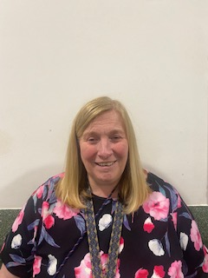
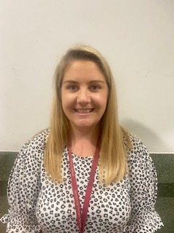
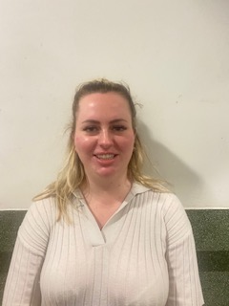
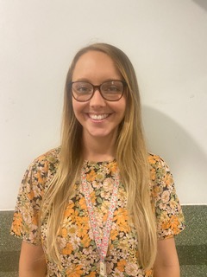
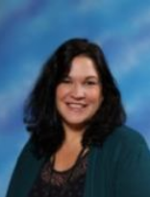
Teachers
Miss Greenwood-
Rabbits class teacher (Tuesdays)
EYFS / Key Stage 1 Lead
Miss Tribe
Rabbits class teacher
KS1 coordinator
Mrs Harvey
Bumblebees class teacher
Miss Ross – Dreher Ladybirds class teacher
Year lead
Mrs Elston
Butterflies class teacher
Mon – Weds
Miss Burns
Butterflies class teacher
Weds afternoon - Fri
Mrs Frith
Bumblebees class teacher
Mrs Marwaha
English and maths support teacher

Slide 3
Adults across Year 1
Mrs Eason
Teaching assistant
Miss Robertson
Teaching assistant

Slide 4
Drop off and pick up
The children can arrive at school between 08.35 – 08.45 where they will complete morning work. We encourage children to arrive as early as they can so this learning can be completed and they can settle into their day.
The children will say goodbye in the main playground and enter up the stairs, through the white door.
The school gates will open at 3.10pm for collection.
All year 1 classes will be lined up in the main playground, close the bike shed area.
Please wait for the class teacher to dismiss the children one by one.
If you wish to speak to the class teacher, please wait until all the children have been dismissed and they will happily do so at this point.

Slide 5
Behaviour expectations
In year 1, we use a behaviour chart consisting of five stages.
Everyone starts on the sun everyday, they can reach the rainbow or shooting star through consistent good behaviour or outstanding personal progress.
If a child carries out inappropriate behaviour e.g. consistently talking on the carpet, they will be given a warning and, if the behaviour fails to improve, they will be moved to the white cloud. If the child gets onto the rain cloud, you will be informed by ping or a conversation at the end of the day.

Slide 6
PE days
PE lessons will take place on the following days:
Ladybirds – Wednesday & Thursday
Bumblebees – Wednesday & Thursday
Butterflies – Monday & Tuesday
Please remember that PE kits need to be worn to school on these days.
Children should not wear earrings to school on these days unless they can remove them independently.

Slide 7
Topics

Slide 8
Class Assemblies
Class assemblies will take place in the Central Hall as they did last year. Parents should wait on the playground after drop off and will be let in through the brown double doors for a start time of 9am.
Bumblebees – Thursday 25th April 2024
Butterflies – Thursday 2nd May 2024
Ladybirds – Thursday 16th May 2024

Slide 9
Year 1 Assessments
Year 1 children will sit their phonics Screening Check in June. They will have daily phonics lessons to learn new sounds and to consolidate and build upon all their learning from reception.
We will be sending out further information about the screening and how to best support your child in the coming weeks and throughout the year.

Slide 10
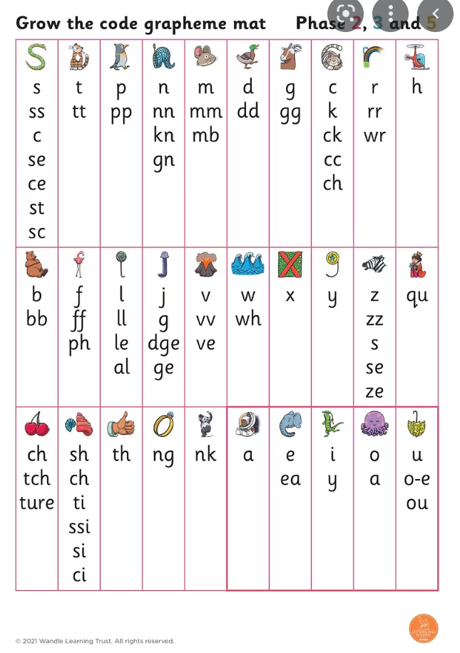
Reading
As in Reception, the children will have reading lessons with their teacher following our school scheme, Little Wandle Letters & Sounds.
They will already be familiar with the reading book they bring home on a Friday and this is great news! The aim is the children build up their reading fluency of the book and share this with you at home. By continuing to read this book over the weekend, this will hugely aid the children’s reading fluency.
Reading books must be returned on Monday mornings. These are needed throughout the week.
The children will visit the library and this will encourage the children to choose books independently and we hope to develop a love for reading.

Slide 11
Reading
Children are expected to read at least 4 times per week. This could be their Little Wandle book or the online version, their library book or a book from home.
The children have access to all their previous books on the Collins ebook website, please use this resources.
This reading needs to be logged in the reading diary that will be checked regularly. The children will be rewarded with a ‘reading superstar’ sticker each Friday if they have managed to complete at least 4 reads (we would love to fill one page of the diary each week).

Slide 12
Support at home
This power point will be sent out (as soon as possible) with an number of attachments to help support your child.
Sound mats
The high frequency and common exception words expected in year 1.
100 squares
Hand writing support

Slide 13
Year group email address – no contact book year1@woodfieldprimary.com
Year group email | School office email
Timetable School trips Reading books Friendships Lost property | Parent pay queries Absence Arrangements for pick up Appointments Club arrangements (if child is starting a new club so they can be directed to the correct location)
Please be aware that although this email will be regularly checked, the teachers are in class so please allow time for a response.
Teachers are also available for an informal discussion after school, once the children have been dismissed.

Slide 14
Reminders
The children do not need their own pencil cases as we have plenty of stationary for the children to use in class.
Morning work starts at 08.30 and this is an important time for the children to recap previous learning, read with a teacher or complete individual tasks. If possible, the children should arrive in school as close to this time to enable them to access this learning.
Please ensure that EVERYTHING brought into school is named.
Children to have a water bottle in school each day.
The children continue to be provided with a free fruit snack each day.
Please take the time to read the weekly newsletter to ensure you are kept up to date with year group news. This will be sent on MCAS each Friday.

