Slide 1
Welcome to Year 3
A presentation for Wood Field parents and carers

Slide 2
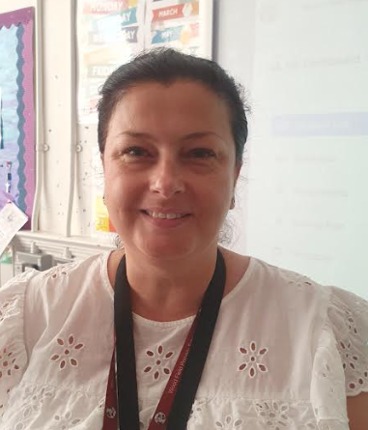
Meet the teachers
Taw
Lea
Dee
Miss. Neilson
Ms. Vijay
Miss Eveleigh
Cam
Mrs. De-Haas
Mrs. Richardson

Slide 3
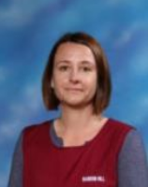
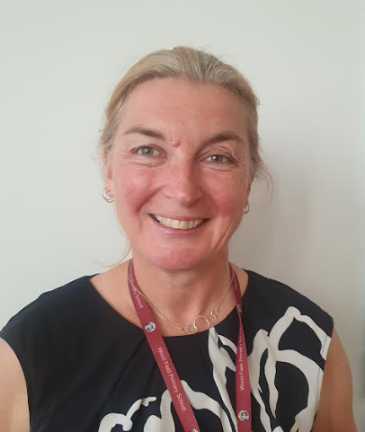
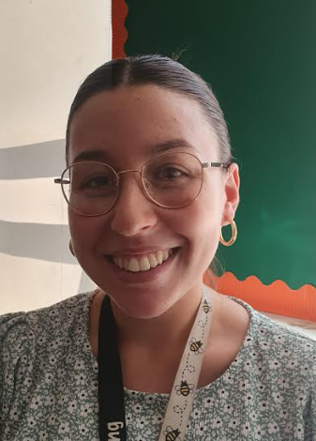
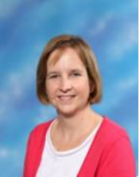
Other adults who help Year 3
Teaching Assistants
Miss Theis
Mrs. Davies
PPA Cover
Mrs Mockett Miss Pointing
Mrs. Taylor (French)

Slide 4
Routine and expectations
Children in class from 8:35am – they will use this time to complete Early Morning Work and it is advised they arrive in school as soon as possible.
We will be encouraging the Year 3 children to walk themselves in from the gates.
Early Morning Work (a variety of short activities used to revise prior learning in Reading, SPaG and Maths)
Reading book and reading record in school every day.
Pick up at the end of the day: 3.15pm from the main playground.

Slide 5
What will Year 3 be learning?
In English, we will use a key text. This text will be shared with the children and used to inspire writing opportunities.
Children will cover the National Curriculum objectives for reading, writing, and SPaG (spelling, punctuation and grammar) through their daily English sessions. There will also be specific reading lessons throughout the week.
In maths, we will follow The White Rose scheme of work which covers the National Curriculum objectives for mathematics. We will also teach specific fluency lessons where number knowledge and times tables will be a key focus.
We will hold an ‘RE Day’ every half term. These days are planned as engaging events where a number of objectives can be taught in succession over the day.
All children will have dedicated PE, music and French lessons.

Slide 6
Years Topics At A Glance
Autumn 1 | Autumn 2 | Spring 1 | Spring 2 | Summer 1 | Summer 2
Art & Design: Drawing: Growing Artists Art & Design: mechanical systems: Painting & MM: Prehistoric painting History Would you prefer to live in the Stone Age, Iron Age, Bronze Age? Science: Movement and nutrition | DT: craft & design: : Structures: Constructing a castle DT: Eating seasonally Geography: Why do people live near volcanoes? Science: Forces and magnets | Art & design: Sculpture & 3D: Abstract shape and space History: Why did the Romans settle in Britain? Science: Rocks and soils | DT: Electronic charm Geography: Who lives in Antarctica? Science: Light and shadows | Art & design: Craft and design: Ancient Egyptian scrolls History: What did the Ancient Egyptians believe? Science: Plant reproduction | DT: Textiles: Cushions or Egyptian collars DT: Mechanical systems: Pneumatic toys Geography: Are all settlements the same?
Trips and visits
Autumn- TBC
Spring – TBC
Summer-
Trip off site TBC
Trip to a Hindu temple in Wimbledon
Year 3 | Science | Movement and nutrition | Forces and magnets |  | Rocks and soils | Light and shadows |  | Plant reproduction | Title TBC
 | Art & Design / Design Technology | Unit 1: Drawing: Growing Artists (4 lessons) Unit 4: Painting & MM: Prehistoric painting (4 lessons) | Unit 2: Structures: Constructing a castle (3 lessons) Unit 3: Cooking and nutrition: Eating seasonally (4 lessons) |  | Unit 3: Sculpture & 3D: Abstract shape and space (5 lessons) | Unit 4: Electronic charm (4 lessons) |  | Unit 2: Craft and design: Ancient Egyptian scrolls (5 lessons) | Unit 1: Textiles: Cushions or Egyptian collars (4 lessons) Unit 5: Mechanical systems: Pneumatic toys (3 lessons)
 | History / Geography | British History 1: Would you prefer to live in the Stone Age, Iron Age, Bronze Age? (6 lessons) | Why do people live near volcanoes? (6 lessons) |  | British History 2: Why did the Romans settle in Britain? (6 lessons) | Who lives in Antarctica? (6 lessons) |  | What did the Ancient Egyptians believe? (6 lessons) | Are all settlements the same? (6 lessons)
 | PSHCE/RSE | Introductory lesson (1 lesson) Family and relationships (6 lessons) | Family and relationships (2 lessons) Health and wellbeing (5 lessons) |  | Health and wellbeing (2 lessons) Safety and the changing body (3 lessons) | Safety and the changing body (5 lessons) Citizenship (1 lessons) |  | Citizenship (6 lessons) | Economic wellbeing (6 lessons) Transition (1 lesson)

Slide 7
Years Topics At A Glance
RSE changes – KAPOW
RSE will be taught in throughout the year.
More information will be sent to parents/carers on the weekly year 3 newsletter.
Year 3 | Science | Movement and nutrition | Forces and magnets |  | Rocks and soils | Light and shadows |  | Plant reproduction | Title TBC
 | Art & Design / Design Technology | Unit 1: Drawing: Growing Artists (4 lessons) Unit 4: Painting & MM: Prehistoric painting (4 lessons) | Unit 2: Structures: Constructing a castle (3 lessons) Unit 3: Cooking and nutrition: Eating seasonally (4 lessons) |  | Unit 3: Sculpture & 3D: Abstract shape and space (5 lessons) | Unit 4: Electronic charm (4 lessons) |  | Unit 2: Craft and design: Ancient Egyptian scrolls (5 lessons) | Unit 1: Textiles: Cushions or Egyptian collars (4 lessons) Unit 5: Mechanical systems: Pneumatic toys (3 lessons)
 | History / Geography | British History 1: Would you prefer to live in the Stone Age, Iron Age, Bronze Age? (6 lessons) | Why do people live near volcanoes? (6 lessons) |  | British History 2: Why did the Romans settle in Britain? (6 lessons) | Who lives in Antarctica? (6 lessons) |  | What did the Ancient Egyptians believe? (6 lessons) | Are all settlements the same? (6 lessons)
 | PSHCE/RSE | Introductory lesson (1 lesson) Family and relationships (6 lessons) | Family and relationships (2 lessons) Health and wellbeing (5 lessons) |  | Health and wellbeing (2 lessons) Safety and the changing body (3 lessons) | Safety and the changing body (5 lessons) Citizenship (1 lessons) |  | Citizenship (6 lessons) | Economic wellbeing (6 lessons) Transition (1 lesson)

Slide 8
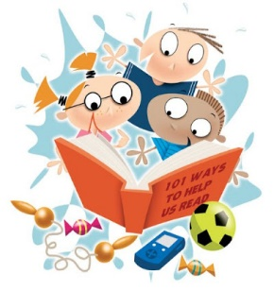
Timetable
Spelling is taught weekly and spelling tests will take place in these lessons.
Spelling tests will take place on a Friday.
PE is taught on the following days:
Cam: Monday and Wednesday
Dee: Monday and Thursday
Lea: Wednesday and Friday
Taw: Monday and Tuesday
Children should come into school in their PE kit on PE days. Long hair must be tied back and earrings must be removed.
If your child can not remove their own earrings, please remove them before the start of the day.
Reading books will be sent home weekly.
Home learning
Weekly spellings will be set.
Reading five times a week is required with evidence in reading record book.
This Photo by Unknown Author is licensed under CC BY-SA

Slide 9
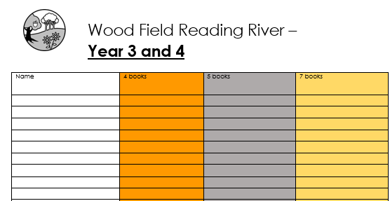
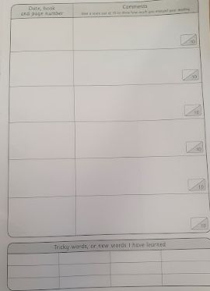
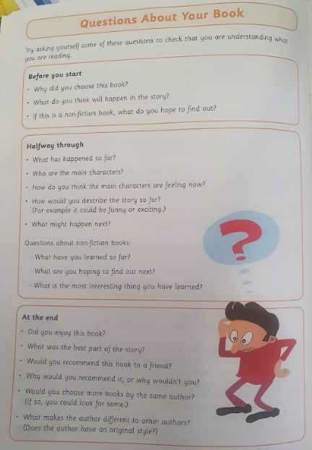
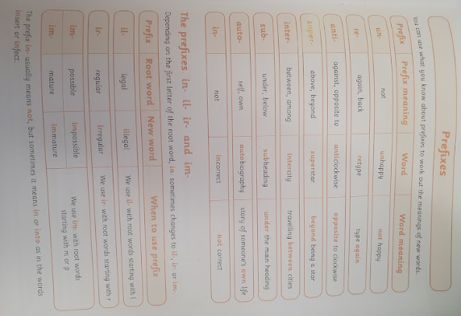
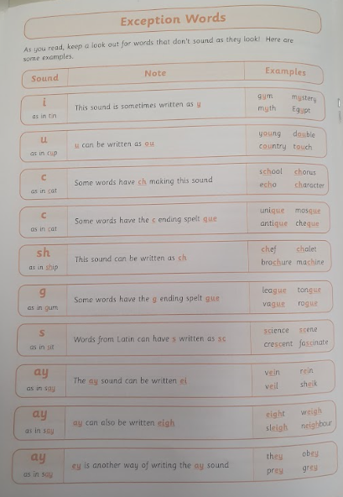
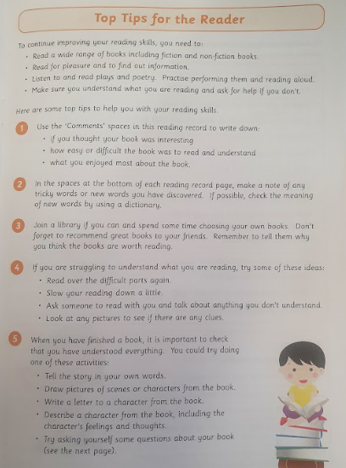
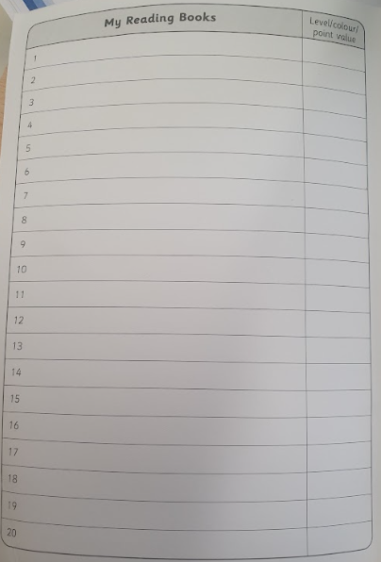
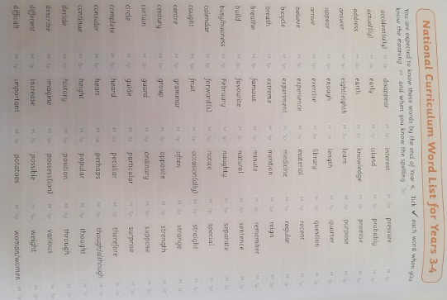
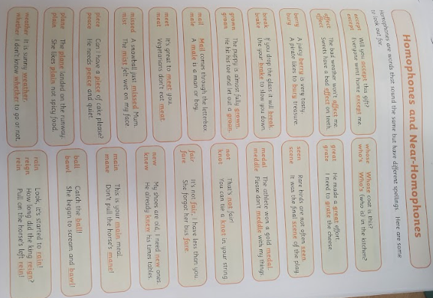
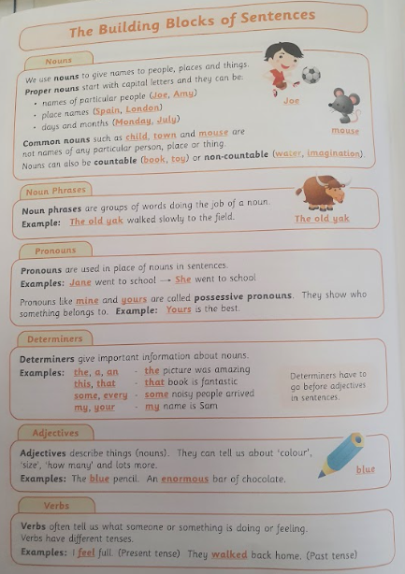
Reading rivers
Children will be able to win a Bronze, Silver or Gold keyring depending on the number of books they have read:
Bronze: 4 books in a year
Silver: 5 books in a year
Gold: 7 books in a year
Reading
Record at least 5 times a week
Other helpful learning.
Tips for the reader
Record books you have read here
Reading books will be sent home weekly.
Questions about the book
Library
We can use the library again. Children can choose a book to borrow and return on their next visit.
This Photo by Unknown Author is licensed under CC BY-SA

Slide 10
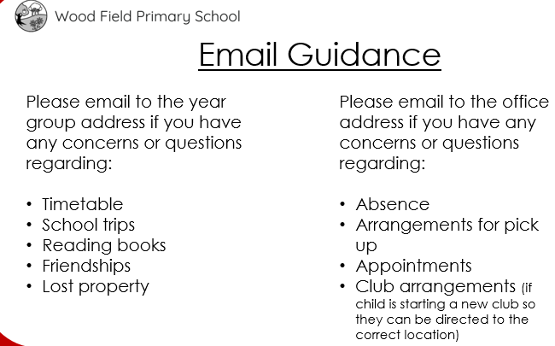
Communication
*If writing an email to the year group address, please state in the subject box who the email is FAO or which class your child is in.
This Photo by Unknown Author is licensed under CC BY-SA

Slide 11
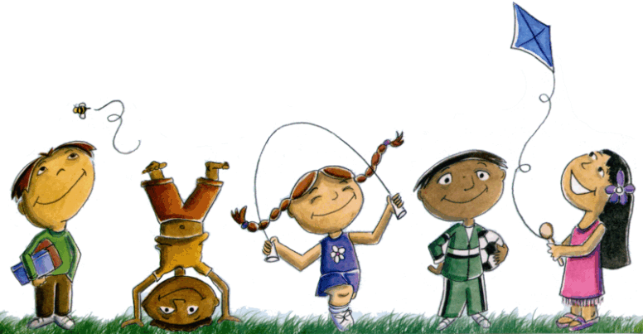
General expectations for Year 3
Please ensure your child’s reading record comes to school daily.
Please ensure all items of clothing are clearly named. This helps us to return lost property to the owner quickly.
Messages can be sent to year3@woodfieldprimary.com instead of using a contact book.
Children are encouraged to bring a named water bottle to school. Bottles with sports caps are preferred as they are less likely to spill.
Children are allowed to bring one, sensible sized pencil case to school. A pencil, rubber, pencil sharpener and a set of coloured pencils are helpful to have in school.
Children are encouraged to bring a snack to school to eat at break time. Please ensure breaktime snacks consist of fresh fruit or vegetables.

Slide 12
Behaviour
In every Year 3 class, there is a behaviour ladder.
All children begin the day on the ‘START LINE’.
Positive recognition: Praise Points
Positive behaviours are recognised, moving children up to the ‘GOLD MEDAL’ in the first instance. Continued excellent behaviour will earn a move to the ‘TROPHY’. Children will receive a praise point
Sanctions: Behaviour Points
Poor behaviour in class or around the school will mean a child is given a warning by being moved onto the ‘WHISTLE’. This is an opportunity for a child to reflect on their behaviour and turn it around. If behaviour improves, this will be recognised and the child can work up the behaviour ladder to the ‘START LINE’ and beyond.
Continued poor behaviour after being placed on the ‘WHISTLE’ will lead to a child being moved to the ‘RED FLAG’. In these cases, a red mark will be issued and parents informed of the behaviour.
Whole class rewards:
Individual teachers will run whole class rewards that are earned over time. These rewards encourage co-operation and teamwork, rewarding the class for working together well. Classes can earn rewards if they work together and individual teachers will inform classes if such rewards are earned.

Slide 13
Behaviour
Praise Points
Pupils will now receive Praise Points when they are show behaviours which deserve reward.
These praise points all have these names:
Kind & Helpful (any behaviour considered to be kind, helpful or similar towards any other members of the school community)
Smart Learning (showing an excellent attitude to learning)
Smart Walking (children being seen walking/lining up around the school sensibly)
Smart Sitting (sitting smartly ready to learn)
If you achieve a set number of praise points, you will earn prizes/rewards.
In KS2, your praise points will also be your house points – they are not separate.

Slide 14
Behaviour
Praise Points
50 Praise Points = First Prize
100 Praise Points = Second Prize
150 Praise Points = Third Prize
Miss Rodger or Miss Ryan will be revealing what these prizes are in assembly soon!

Slide 15
Praise Points
Kind & Helpful (any behaviour considered to be kind, helpful or similar towards any other members of the school community)
Smart Learning (showing an excellent attitude to learning)
Smart Walking (children being seen walking/lining up around the school sensibly)
Smart Sitting (sitting smartly ready to learn)
Make sure that you’re doing your best to show all of these behaviours at all times – these are the things that your teacher and all other staff around the school will be looking out for and praising you for – if they’re really impressed then they might even give you a praise point!
Behaviour

Slide 16
Behaviour
Praise Points
On the app that the school use to communicate with parents and carers, your praise points will be shown on here – this means that your grown ups will be able to see when you’ve been doing great things!!!

Slide 17
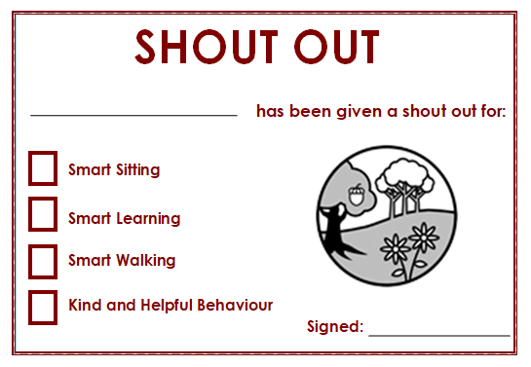
Behaviour
For our spotlight assemblies, teachers will have one spotlight shout out per category to read out each week.
If you get a shout out, this also means that you will have a praise point added.

Slide 18
Behaviour
Behaviour Points
For behaviours negative behaviours, children may receive a behaviour point.
If your name is moved down twice on your class behaviour chart, you will get a behaviour point. You could also get a behaviour point if you do something serious which goes against our school rules.
In KS2, behaviour points are effectively replacing Red Marks.

Slide 19
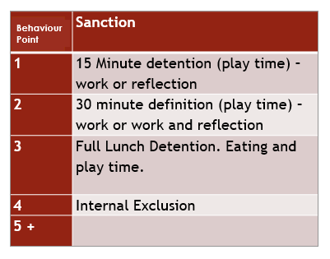
Behaviour

Slide 20
Behaviour
As a school, we recognise the importance of consistent behaviour management and the importance of promoting positive behaviour at all times.
We recognise that if consequences do need to be issued, they should be fair and relate to the level of behaviour that has led to the consequence.
Below are some of the consequences which may occur for behaviours of the different levels. Consequences will be selected by the staff dealing with the behaviour and will relate to severity of the behaviour and the context of the behaviour. The consequences listed below are not the only consequences that may arise and staff may choose to issue a consequence that is not listed below in some circumstances.
A behaviour point can be received for an isolated incident or for a child having their name moved down more than once. As per the school’s behaviour policy, a red mark results in a detention. 4 behaviour marks in a half term results in an internal exclusion.

Slide 21
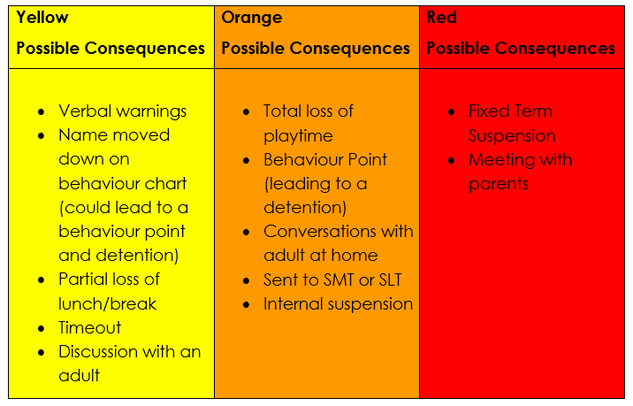
Behaviour

Slide 22
Behaviour
Levels of Behaviour
Understanding the different levels of behaviour can help all members of the Wood Field community to develop a shared understanding of behaviour and consequence.
Continuing a behaviour after being told/asked to stop means that the behaviour moves up to the next level. Depending on severity, SLT may choose to view a specific behaviour as a different level in some circumstances.
As a school, we also recognise that we have to make adjustments for children with specific needs.

Slide 23
Behaviour
Leaving the room without permission
Actions with intention to provoke another child
Putting yourself or others in danger
Racism, homophobia or any other forms of discrimination
Violence/attempted violence
Damaging school property or someone else’s property
Talking when you shouldn’t be
Disrupting others from their learning
Swearing
Contiued/repeated defiance
Inappropriate contact towards another child
Leaving your chair in class
Extended periods of disrupting others
Intentional assault
Saying something inappropriate
Repeatedly carrying out any Yellow behaviours
Not following school or class rules
Calling out
Repeatedly carrying out any Level 2/Orange behaviours
Defiance
Disruption which leads to a class having to leave a lesson or activity
Rough play
Being somewhere I should not be
Swearing or shouting aggressively at adults

Slide 24
Organisation
Blue marks are given to pupils in Key Stage 2.
Here is a guide on when they will be issued to Year 3 pupils and the associated sanctions.
Please be aware that there is a transition period before we issue Blue marks to allow Year 3 pupils to adjust to Key Stage 2 expectations.
Blue Marks are given for:
No 5 signatures/ comments for reading per week
Incorrect uniform
To start officially from Autumn term 2 to allow children to get used to rules
4 blue marks = lunchtime detention

Slide 25
Class Assemblies
Year 3 Class Assemblies
Dee Class – Thursday 8th February 2024
Lea Class – Thursday 22nd February 2024
Cam Class – Thursday 28th February 2024
Taw Class – Thursday 14th March 2024

Slide 26
Support at home
In Year 3 we encourage parents and carers to work in partnership with us to support their child’s learning.
You can make a big difference by supporting us in the following ways:
Reading: Please do encourage children to read at home. There is an expectation that reading will be recorded in their reading record books at least five times a week. Reading can include a book from home or Reading Planet. Remember the children will also be able to move along the reading river!
Times Tables Rockstars: Please ensure your child logs in regularly to make use of this online platform. It is a fun and engaging way of learning multiplication tables and improving a child’s recall speed.
Spelling: Spellings will be issued each week. Children will be given 10 spellings and a spelling rule or pattern to investigate. Look, cover, spell, check sheets will be uploaded to support children learning their spellings at home.

Slide 27
Thank you!
We look forward to working with you.
The Year 3 team

