Slide 1
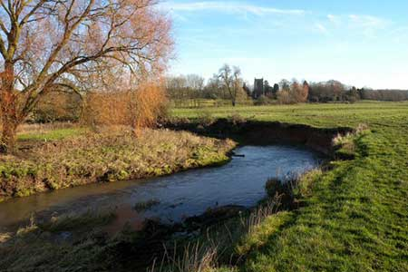
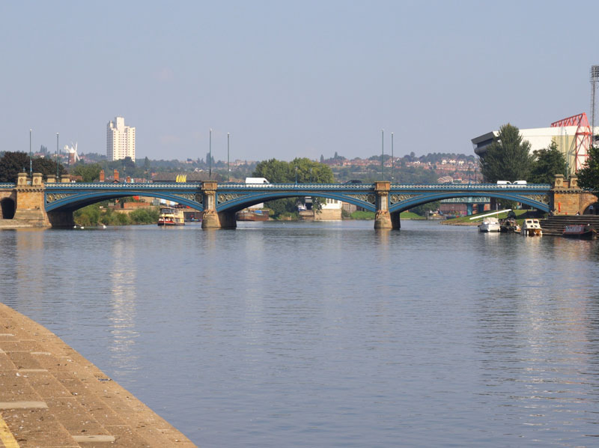
Welcome to Year 5!

Slide 2
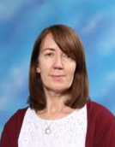
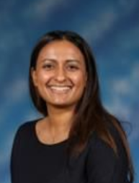
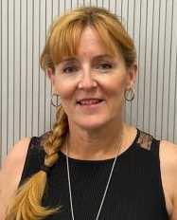
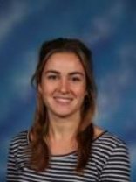
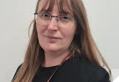
Teachers
Mrs Cutler-
Trent class teacher
Mrs Bansal- Ashby class teacher
Year lead
Teaching Assistants:
Mrs Shah
Mrs Hooper
Mrs Mockett
Mrs Moody
Miss Freeland
Ms Tabassum
Mrs Bent- Tamar class teacher
Miss Hawkins-
Arrow class teacher
Miss Johnston -
Upper key stage lead

Slide 3
Routine and expectations
Children in class from 8:35am – they will use this time to complete Early Morning Work and it is advised they arrive in school as soon as possible. The register will now be taken at 8:45am.
Early Morning Work (a variety of short activities used to revise prior learning in Reading, SPaG and Maths)
Reading book and reading record in school every day.

Slide 4
Communication
All communication must be via the year group email address – year5@woodfieldprimary.com . Each Year Group has an email address for you to contact the class teachers directly. If you have any concerns or questions regarding the timetable, school trips, reading books, friendships, lost property etc.
If your child will be walking home from school independently we MUST have a letter or email with your written permission.
For those children who bring a phone to school, it must be switched off on entry and handed to the class teacher. Phones cannot be switched on at the end of the day while on the premises.
A lot of important information will be sent via MCAS (My Child At School). If you do not already have this, please download the app.

Slide 5
Email Guidance
Please email to the year group address if you have any concerns or questions regarding:
Timetable
School trips
Reading books
Friendships
Lost property
Please email to the office address if you have any concerns or questions regarding:
Absence
Arrangements for pick up
Appointments
Club arrangements (if child is starting a new club so they can be directed to the correct location)

Slide 6
Homework
Reading (5 times per week)
15-20 minutes or 20 pages
Log must be signed by an adult
Spellings
Weekly test
Formal homework will start in the spring term in preparation for year 6.

Slide 7
Reading expectations
The expectation is that the reading record is signed 5 times in 7 days to show the children have read at home.
The class teacher will check this every Monday for the previous week.
Use the central pages of the reading records to support your child’s reading. These questions have got examples of questions you could ask your child as they read.
All reading entries must be dated and signed by an adult at home.

Slide 8
Equipment
Pencil Case
Blue Handwriting Pen (no biro please)
Pencil
Colouring Pencils / Pens
Rubber
Sharpener
Ruler
Water bottle
Children can bring in a healthy snack (fruit/vegetables) for break time

Slide 9
PE days
PE lessons will take place on the following days:
Ashby class- Tuesday and Thursday
Arrow class- Tuesday and Friday
Tamar class- Tuesday and Wednesday
Trent class- Monday and Tuesday
One PE lesson is indoors and one is outdoors.
Please remember that children will not be changing for PE in school.
Children need to come into school wearing their PE kits and trainers on their PE days.
Swimming lessons will take place during Year 5.
Ashby and Trent Autumn term (starting 21st September)
Arrow and Tamar Spring term

Slide 10
Behaviour expectations
We will continue with our existing policy of names being moved up/down on behaviour charts.
Each day, every child will begin on ‘Start Point’ and will progress to ‘Recognition’.
For an outstanding day, children will receive a praise point.
If a child receives a warning, they will move to the ‘Warning’. This can be rectified by improved behaviour and children can be moved back to ‘ Start Point’.
Upon a second warning, children will be moved down ‘ Consequence.’ This means that the child will receive a behaviour point.

Slide 11
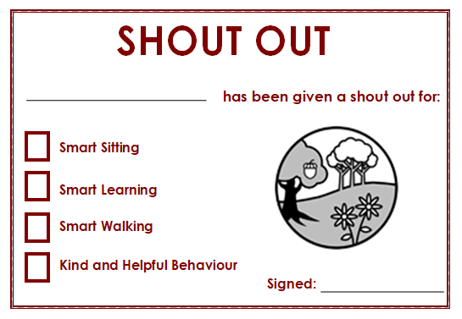
Behaviour expectations
Praise Points
Pupils will now receive Praise Points when they are show behaviours which deserve reward.
These praise points all have these names:
Kind & Helpful (any behaviour considered to be kind, helpful or similar towards any other members of the school community)
Smart Learning (showing an excellent attitude to learning)
Smart Walking (children being seen walking/lining up around the school sensibly)
Smart Sitting (sitting smartly ready to learn)
In KS2, praise points will also be house points
– they are not separate.

Slide 12
Behaviour expectations
Behaviour Points
For negative behaviours, children may receive a behaviour point.
If their name is moved down twice on the class behaviour chart, they will get a behaviour point. They could also get a behaviour point if they do something serious which goes against our school rules.
In KS2, behaviour points are effectively replacing Red Marks.
On the app that the school use to communicate with parents and carers, praise and behaviour points will be shown on there.

Slide 13
Social media
Facebook
Instagram
Tik Tok
Snapchat
Twitter
Wink
WhatsApp
All of these Social Media platforms have a minimum age restriction of 13+. The minimum age for WhatsApp is 16+. This is for a reason.
We are finding more and more that issues are being brought into school, which have originated from use of these platforms at home. These issues are incredibly hard for us to deal with in school as we cannot monitor them outside of school. We are, therefore, reliant on parent support to ensure that we can minimise these experiences for our children.

Slide 14
Social media
Facebook, Instagram and Twitter are platforms which allow children to communicate with others as well as view content by friends and celebrity accounts.
Not only does the ability to communicate with others create a risk to children – allowing strangers to follow their accounts and start conversations as well as using inappropriate/unkind language or sharing inappropriate content with others they know – it also can mean that children are exposed to inappropriate content and language from other account’s posts.
This has led to children seeing images, videos and language that contains inappropriate content as well as having a huge impacts on children’s self-esteem and confidence.
We strongly recommend that children do not use these apps due to the vast number of issues it creates, however if you are making the choice for your child to have these apps, please ensure that you monitor who they are following and the appropriateness of these accounts as well as who is following them and what conversations they are having.
As a school, we cannot take any responsibility for any incidents that take place on these apps. We ask that parents monitor their child’s phones to ensure content is appropriate. We will of course inform parents if this behaviour is made known to us and request that parents take action when informed of any situations that may occur.
Facebook
Instagram
Tik Tok
Snapchat
Twitter
Wink
WhatsApp

Slide 15
Social media
Facebook
Instagram
Tik Tok
Snapchat
Twitter
Wink
WhatsApp
WhatsApp, Wink and Snapchat are platforms which allow children to communicate with each other and their families. We find that many issues on these apps arise from children using unkind language towards each other and sending links, photos and videos with inappropriate content to each other. WhatsApp is by far causing the most issues.
If the app settings aren’t set correctly, children find they are being added to multiple groups including large numbers of children – some of whom they don’t even know and may not be of the same age.
We strongly recommend that children do not use these apps due to the vast number of issues it creates, however if you are making the choice for your child to have these apps, please ensure that their settings do not allow them to be added by other contacts to groups.
As a school, we cannot take any responsibility for any incidents that take place on these apps. We ask that parents monitor their child’s phones to ensure content is appropriate. We will of course inform parents if this behaviour is made known to us and request that parents take action when informed of any situations that may occur.

Slide 16
Social media
Facebook
Instagram
Tik Tok
Snapchat
Twitter
Wink
WhatsApp
Tik Tok is a platform which allows children to communicate with each other as well as view and post videos from other accounts. We find that many issues on this app arise from children using unkind language towards each other as well as creating, sharing and viewing videos with some incredibly inappropriate content to each other.
The difference that we find with Tik Tok compared to any other app is that it cannot be manipulated via settings to only show child-appropriate content. This app runs on an algorithm which can be dangerous if children come across the wrong sort of videos. It is incredibly hard (almost impossible) to monitor what your children are being exposed to on this app
Content that your child could be exposed to includes graphic, physical violence, reference to suicide racism, homophobia, sexualised content, extremist views and much more.
We strongly recommend that children do not use this app due to the vast number of issues it creates, and there is almost no way of monitoring what your children are seeing while using it.
As a school, we cannot take any responsibility for any incidents that take place on this app. We will of course inform parents if any concerns are made known to us and request that parents take action when informed of any situations that may occur.

Slide 17
Topics
Autumn 1 | Autumn 2 | Spring 1 | Spring 2 | Summer 1 | Summer 2
What did the Greeks ever do for us? Greek day at school - Monday 16th October | What is life like in the Alps? | What was life like in Tudor Britain? Hampton Court Trip | Why do oceans matter? | How did the Maya civilisation compare to the Anglo Saxons? Mayan workshop | Would you like to live on a desert?

Slide 18
Class assemblies in Year 5
This year, we will be inviting parents to school for children to showcase their learning, in the form of a special class assembly. These assemblies will be held on a Thursday, between 9 and 9.30am, in the Central Hall.
9th November 2023 : Tamar Class
16th November 2023 : Trent Class
23rd November 2023 : Arrow Class
30th November 2023: Ashby Class

Slide 19
Extra support at home
Times Table Rockstars
Maths frame website
Reading
Spelling practise

